Slide 1

Introduction to Data Science: Data Types, Lifecycle, and Applications

Slide 2


UNDERSTANDING
What Is Data Science?
Data Science combines statistics, programming, and machine learning to extract valuable insights from data. It's the art and science of uncovering patterns and making sense of the vast amounts of information generated every second.
Informed Decisions
Predictive Power
Empowers organizations to make data-driven choices.
Forecasts future trends and potential outcomes.
Hidden Patterns
Uncovers previously unseen relationships in data.
For example, Netflix masterfully uses data science to recommend shows and movies tailored to your individual viewing habits, enhancing user experience and engagement.

Slide 3

GLOBAL IMPACT
Why Data Science Matters Today
The digital world generates an unimaginable volume of information. With over 40 zettabytes of data globally—that's 40 trillion gigabytes—every interaction leaves a digital footprint.
Data Everywhere
Every click, purchase, and social media post contributes to this massive data ocean.
From Chaos to Clarity
Data science acts as the bridge, transforming raw, chaotic data into structured, actionable knowledge, driving progress across all sectors.

Slide 4
THE BUILDING BLOCKS
Key Data Types in Data Science
Understanding the nature of data is fundamental. Data comes in various forms, each requiring different analytical approaches.
Categorical (Qualitative)
Numerical (Quantitative)
Represents categories or labels. It's about grouping observations based on shared characteristics.
Consists of measurable numbers, allowing for mathematical operations and statistical analysis.
Gender (Male, Female, Non-binary)
Colors (Red, Blue, Green)
Product Types (Electronics, Apparel, Books)
Height (e.g., 175 cm)
Temperature (e.g., 25°C)
Sales Figures (e.g., $1500)
1
2
Ordinal
Nominal
Ranked categories, where order matters (e.g., movie ratings: 1-5 stars).
Unordered categories, with no inherent ranking (e.g., hair color: blonde, brown, black).
3
4
Discrete
Continuous
Countable numbers, typically integers (e.g., number of students in a class).
Measurable values that can take any value within a range (e.g., weight, temperature).

Slide 5
THE JOURNEY
The Data Science Lifecycle: From Raw Data to Insights
The data science journey is a structured process that transforms raw data into actionable intelligence, driving value and innovation.
Define the Problem
Collect Data
Clean & Prepare
Clearly understand the business challenge and formulate specific questions.
Gather relevant data from diverse sources like databases, web logs, and IoT sensors.
Ensure data quality by removing errors, handling missing values, and normalizing formats.
Analyze & Model
Communicate Results
Apply statistical techniques and machine learning algorithms to uncover patterns and build predictive models.
Translate complex findings into clear, concise insights for effective decision-making.

Slide 6
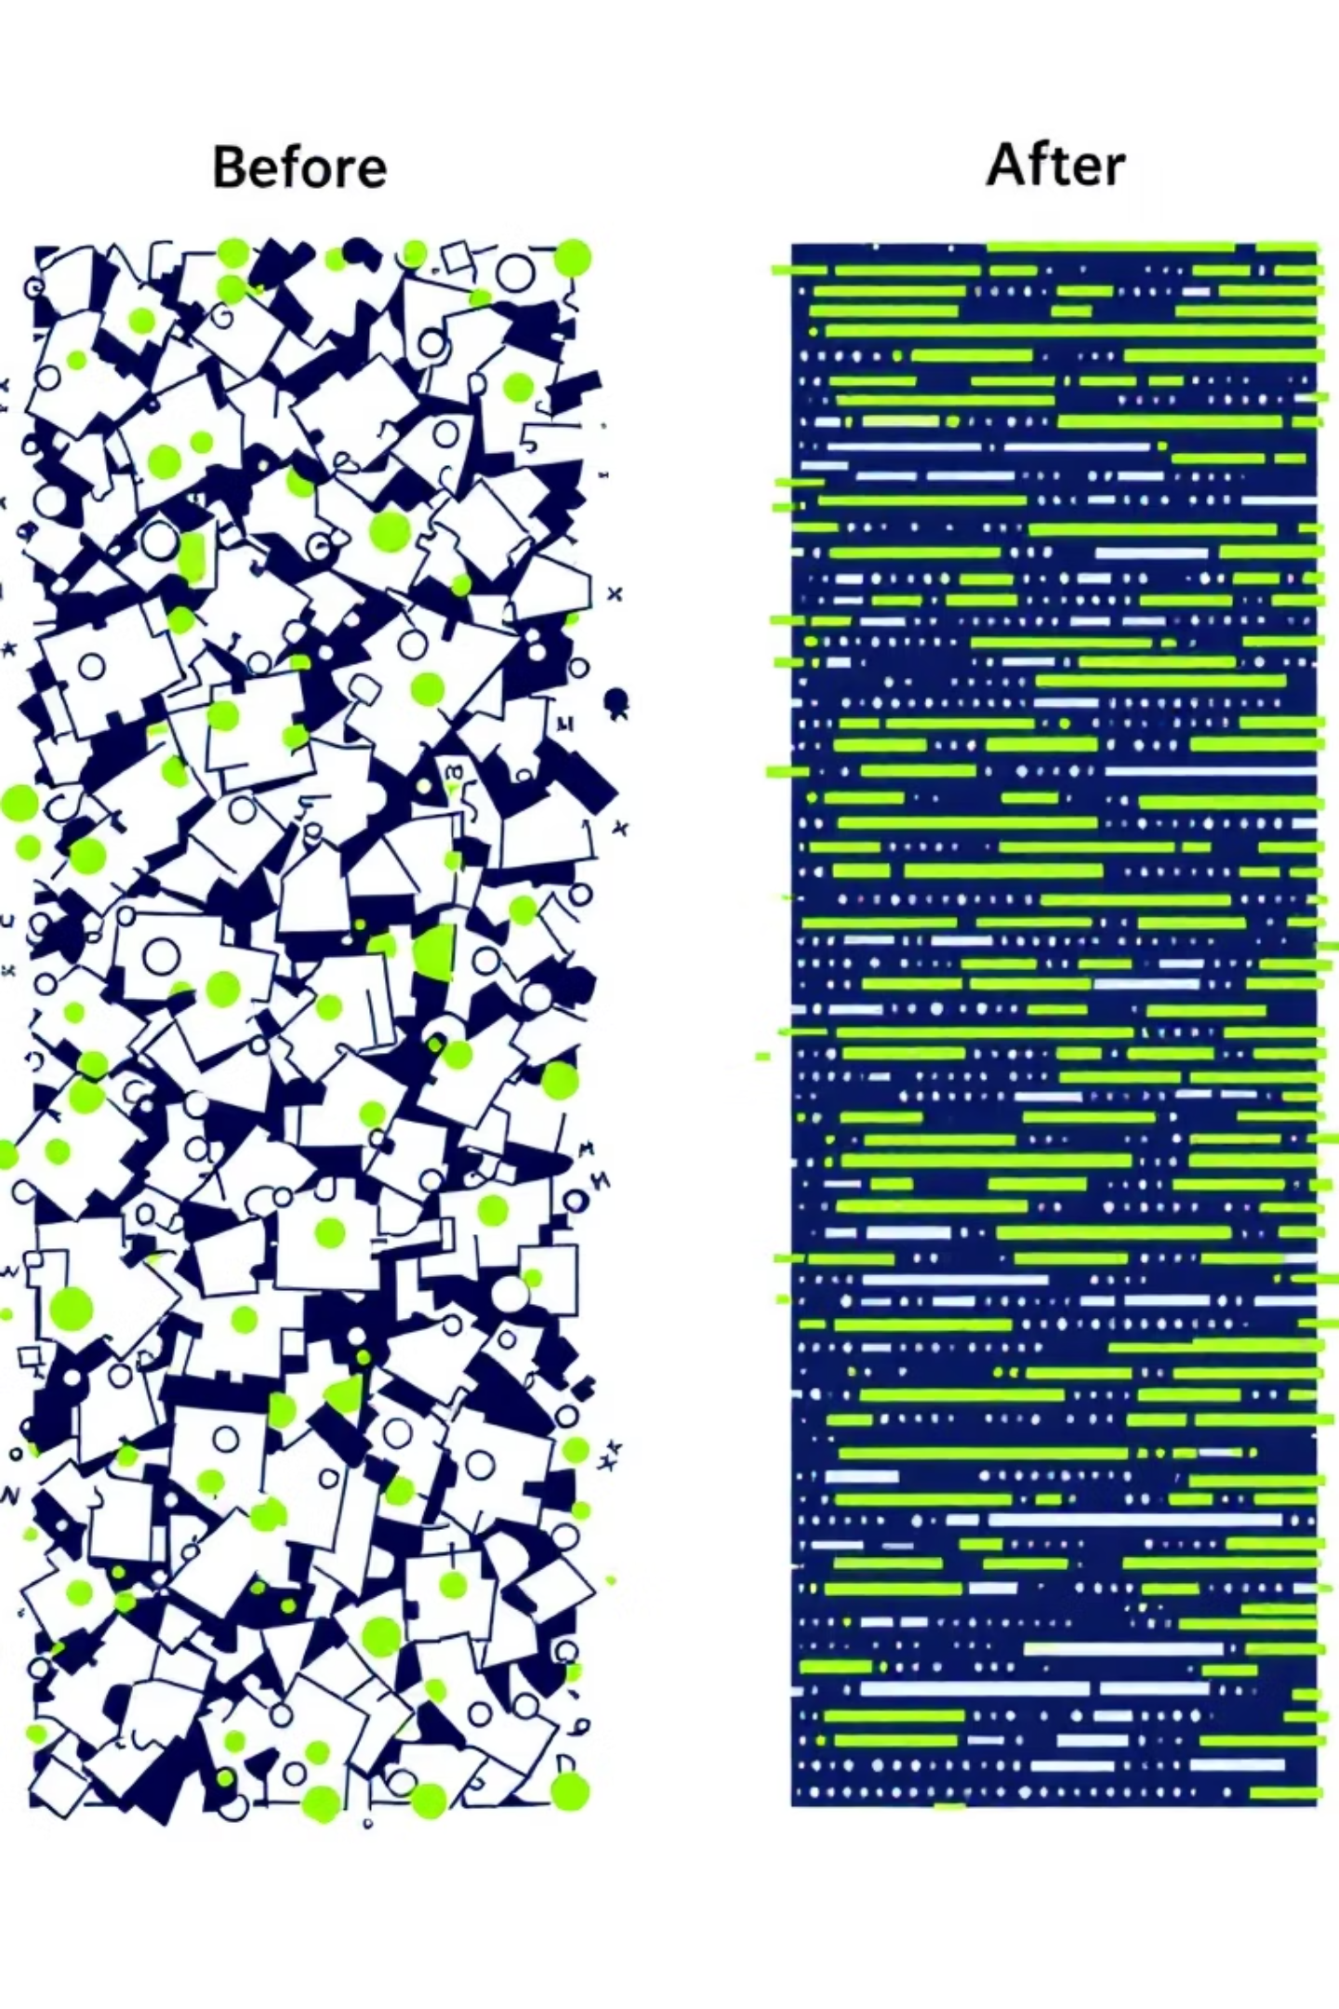
THE ESSENTIAL STEP
Data Cleaning: The Unsung Hero
Data cleaning, though often overlooked, is a critical phase in the data science lifecycle. It ensures that the insights derived are based on accurate and reliable information.
Standardizing Data
Normalizing varying data formats, such as converting all height measurements to meters (e.g., 140 cm becomes 1.4 m, 1.8 m remains 1.8 m).
Addressing Missing Values
Strategically filling in gaps by replacing missing entries with averages, medians, or more sophisticated estimates based on other data points.
Impact on Models
Thorough data cleaning prevents biases and inaccuracies, leading to more robust and trustworthy analytical models.

Slide 7
IMPACT IN ACTION
Real-World Applications of Data Science
Data science is not just theoretical; it's actively transforming industries and improving lives across the globe.
Healthcare
Finance
Predicting disease outbreaks, personalizing treatment plans, and accelerating drug discovery.
Detecting fraudulent transactions, forecasting market trends, and optimizing investment strategies.
Transportation
E-commerce
Optimizing logistics, managing traffic flow, and enabling the development of autonomous vehicles.
Delivering personalized product recommendations (e.g., Amazon's "Frequently Bought Together" feature), optimizing pricing, and enhancing customer experience.

Slide 8

AUTONOMOUS FUTURE
Case Study: Driverless Cars
Autonomous vehicles stand as a prime example of data science in action, integrating complex data streams to achieve safe and efficient navigation.
Sensor Fusion
Machine Learning Brain
Utilize an array of sensors (LiDAR, radar, cameras) to collect real-time environmental data.
Machine learning algorithms process this data to perceive surroundings, predict movements, and make instantaneous driving decisions.
Dynamic Adaptation
Key Benefits
Continuously analyze speed limits, traffic patterns, and road conditions, adapting navigation in real-time.
The integration of data science aims to significantly reduce accidents, alleviate traffic congestion, and enhance overall transportation efficiency.

Slide 9

THE TOOLKIT
Skills Behind Data Science
A successful data scientist possesses a diverse skill set, blending technical prowess with critical thinking and strong communication.
Technical Proficiency
Analytical Mindset
Deep expertise in statistics, probability, programming (Python, R, SQL), and database management.
The ability to formulate insightful questions and translate complex data into clear, actionable business value.
Continuous Learning
Staying abreast of the rapidly evolving landscape of data science tools, techniques, and technologies.

Slide 10

LAUNCH YOUR JOURNEY
The Future of Data Science: Your Journey Starts Here
Data science is not merely a trend; it's a fundamental shift, reshaping every industry and creating a wealth of new career opportunities.
Foundation First
A solid understanding of data types and the data lifecycle forms your essential groundwork.
Embrace Curiosity
Cultivate a curious mindset, constantly seeking to uncover insights and solve problems.
Hands-on Practice
Engage in practical projects to apply your knowledge and build a robust portfolio.
Unlock Potential
Harness the transformative power of data to drive innovation and make a meaningful impact.

